Slide 1


Standards to Enable an Open Learning Ecosystem
Dr. Charles Severance
University of Michigan School of Information
IMS Global Learning Consortium
#NercompPDO4

Slide 2
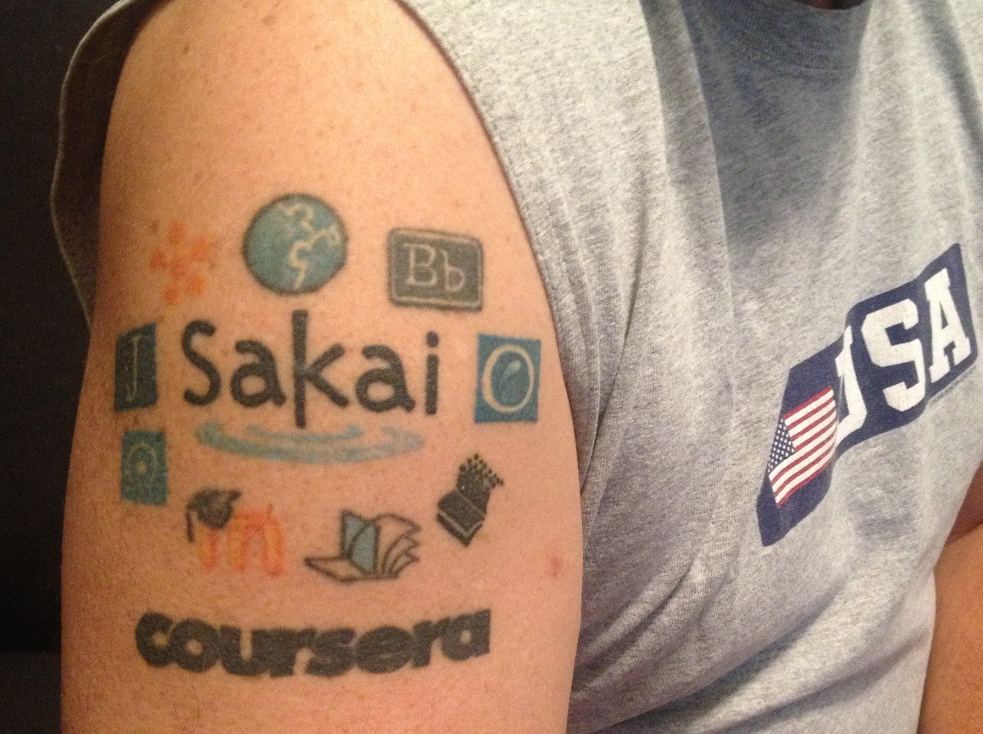
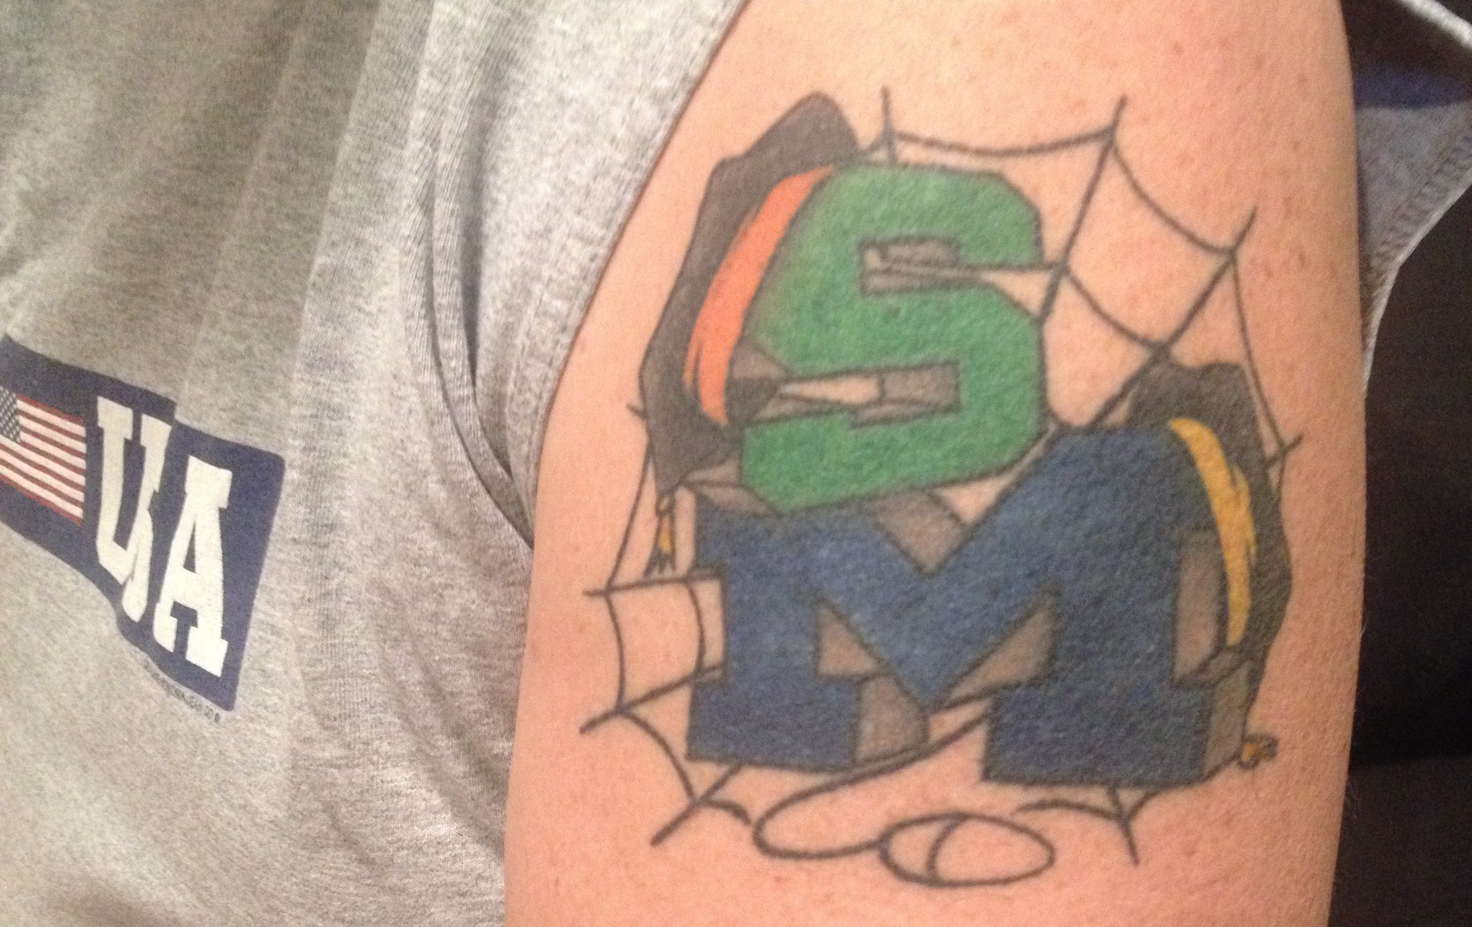
Disclaimer
What I am about to talk about is not an official direction or position of the University of Michigan, Longsight, nor IMS Global.

Slide 3
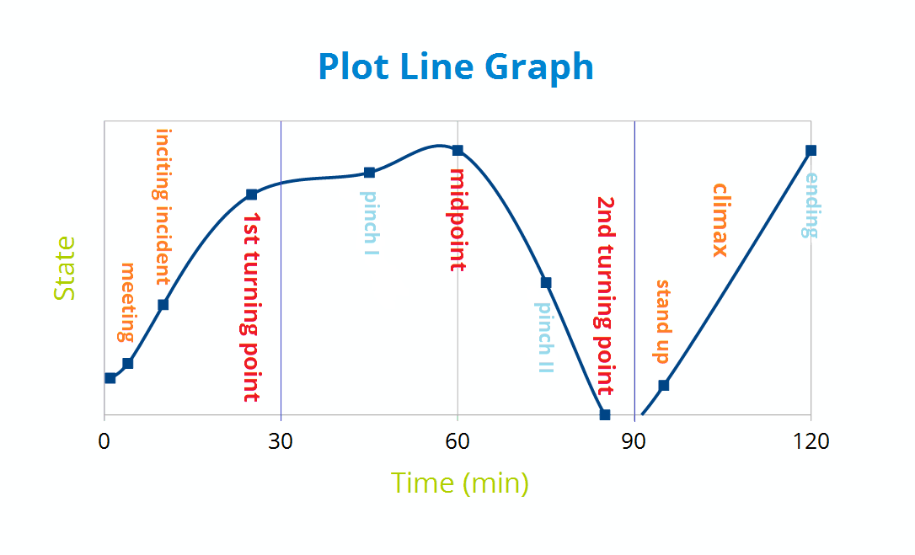
A Three-Act Play
https://en.wikipedia.org/wiki/Three-act_structure
Notes:
Protagonist confronts an incident. Attempts to deal with the incident lead to a second incident. Second act – ever worsening conditions. Character arc / growth – not done alone. Third act story resolution including all subplots. Climax – point where core questions are answered.

Slide 4
A Three-Act Play
Meet the characters. Something happens to the protagonist. Their solution makes things worse.
Rising action. Each new attempt at a solution makes things worse. Character must grow or learn – helped by others.
The plot and sub-plots are resolved. The climax is the most intense moment when the main question is answered.
https://en.wikipedia.org/wiki/Three-act_structure

Slide 5
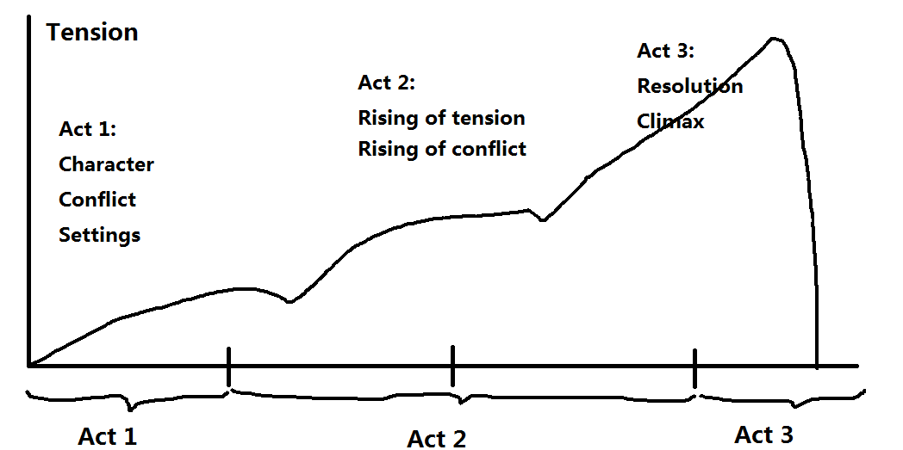
A Three-Act LMS Play
https://en.wikipedia.org/wiki/Three-act_structure

Slide 6
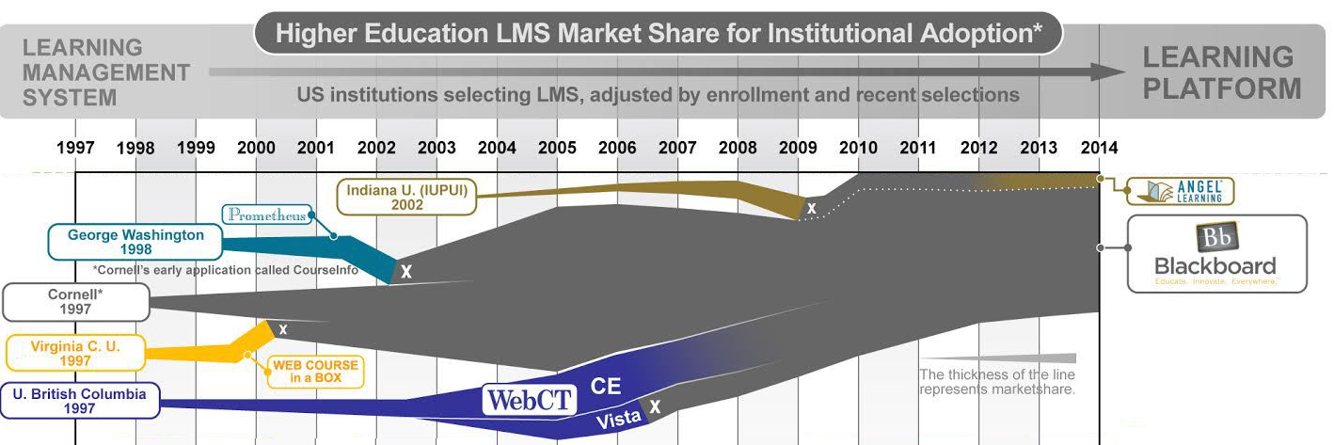
Act I – Lone Prospectors
http://mfeldstein.com/back-to-the-future-looking-at-lms-forecasts-from-2011-2014/

Slide 7
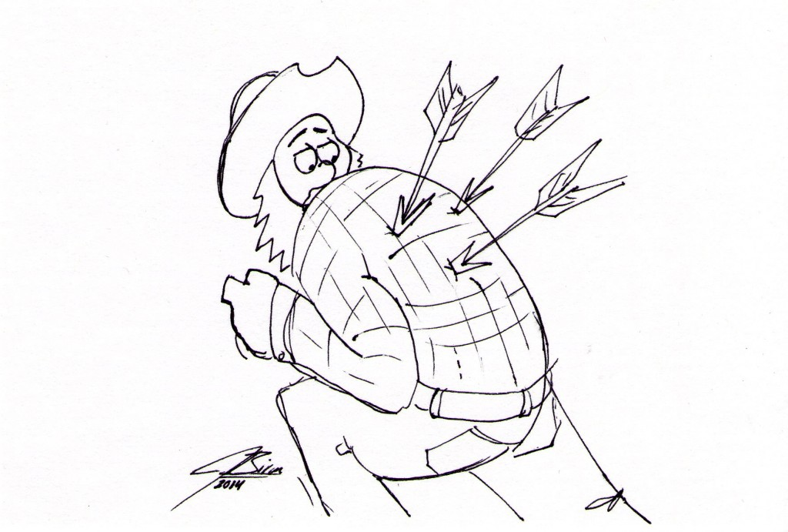
Foreshadowing
Blackboard Learn reaches is maximum market share in 2005
Notes:
The web is 3 years older than LMS systems.

Slide 8





Act I - Summary
Notes:
Backboard realized this was $$$ - when someone would compete – they bought them. Stayed 1-2 years ahead of everyone else.

Slide 9
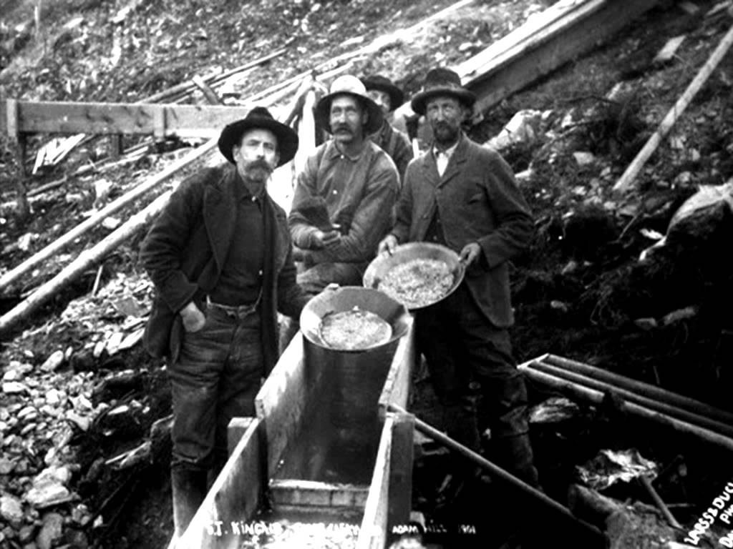
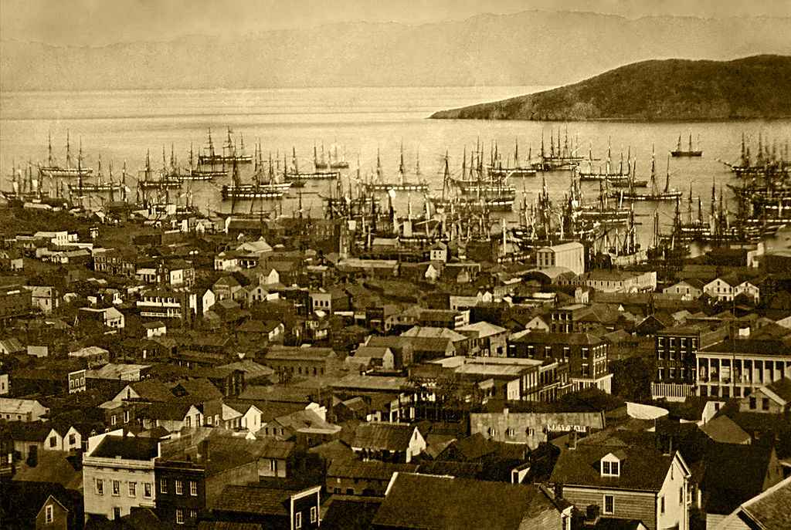
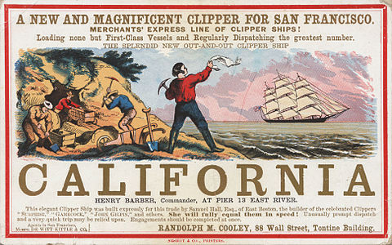
Act II Starts – Gold Rush

Slide 10
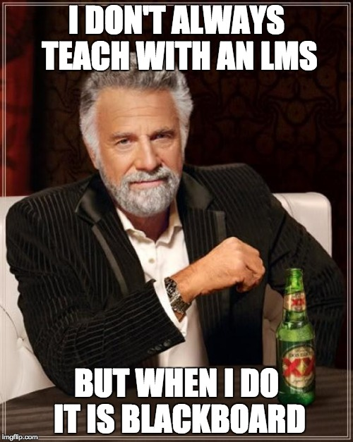

Slide 11

D'Arcy Norman's Law of eLearning Tool Convergence
Any eLearning tool, no matter how openly designed, will eventually become indistinguishable from a Learning Management System once a threshold of supported use-cases has been reached.
http://darcynorman.net/2013/02/15/normans-law-of-elearning-tool-convergence/

Slide 12
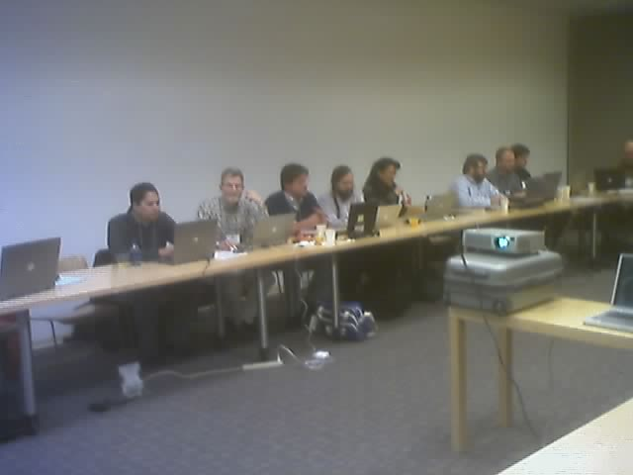
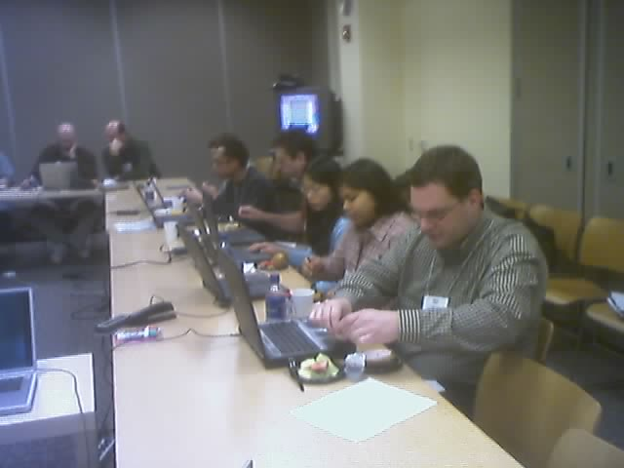
Team Sakai (2004)
Notes:
Can't be bought.

Slide 13
A Three-Act LMS Play
https://en.wikipedia.org/wiki/Three-act_structure

Slide 14
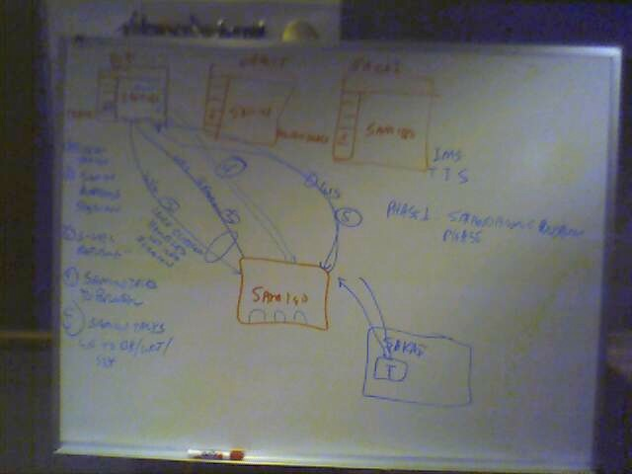
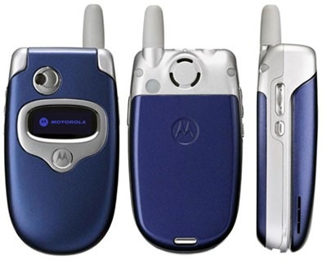
IMS TI Begins
Brainstorming at IMS Meeting in Denver 2004-10-19

Slide 15
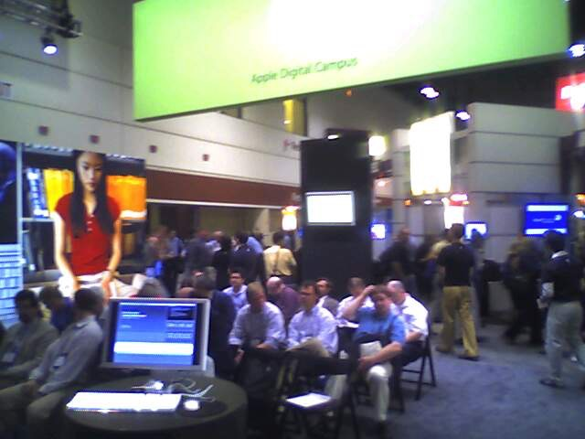
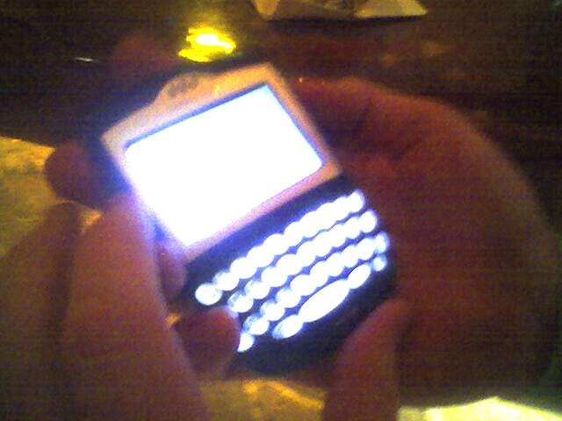
Apple Booth @ Educause
2005 (and 2006)
Notes:
Apple had lost the K-12 market. When was the iPhone introduced? 2007

Slide 16
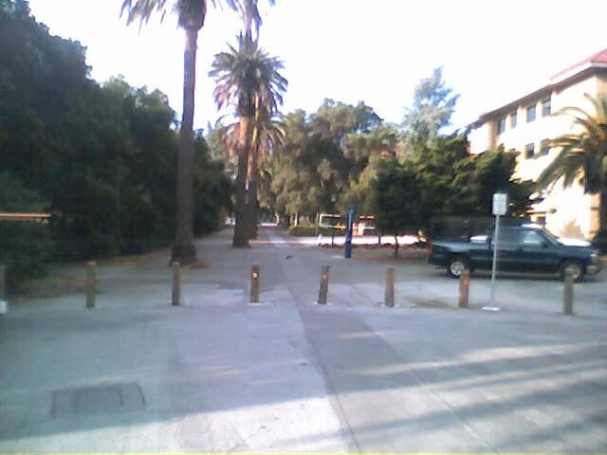
Publisher Meeting @ Stanford
Colleagues:
It looks like we have about 25 individuals (give or take) attending the SCP/SCA/Board meeting on 4/27/2005 from 1-5 pm. This includes the Board (9). See list below. At this point, I'd rather not invite any more people.
Textbook Publishers Invited/Attending...............................................
Allen Noren, O'Reilly & Associates -- ATTENDING
Ray Henderson, Pearson Education -- ATTENDING
Schoen, Steve, Thomson Higher Education -- ATTENDING
David Serbun, Houghton Mifflin Company -- ATTENDING
Jonathan Stowe, John Wiley & Sons, Inc. -- ATTENDING
Glenn Kammen, Intelecom -- ATTENDING
Vivian 'Vivie' Sinou
Dean, Distance & Mediated Learning
Foothill College

Slide 17
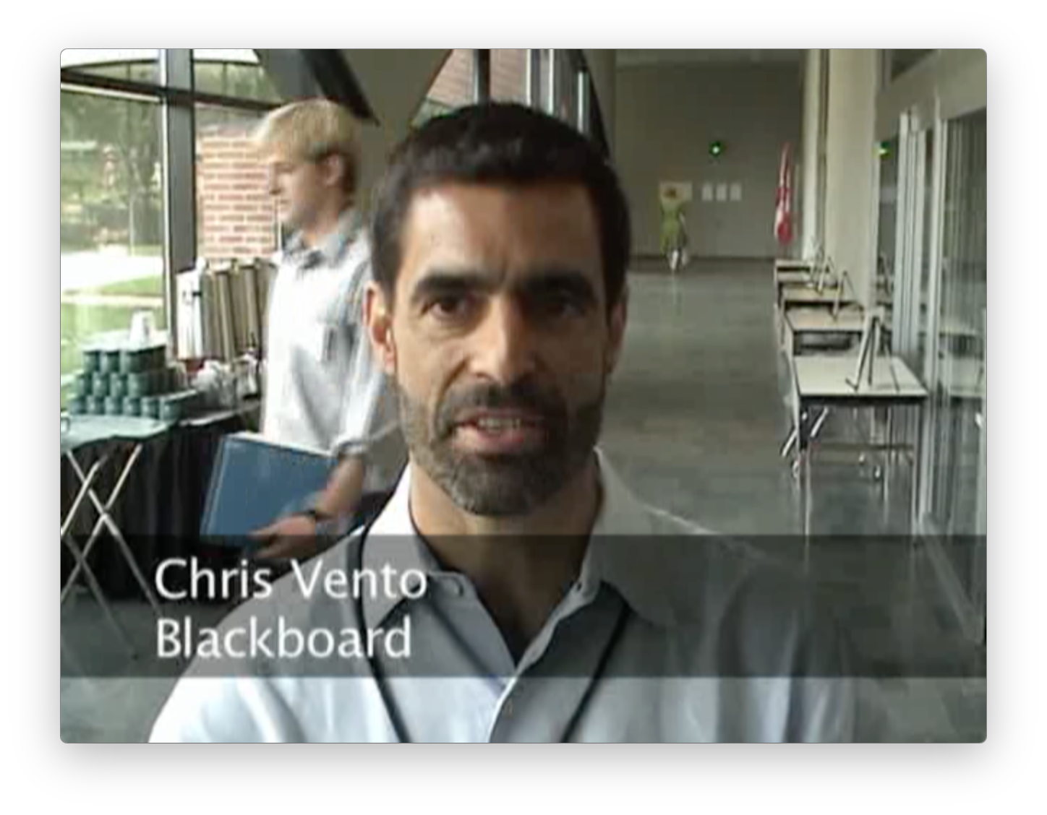
https://www.youtube.com/watch?v=nOvNDey2QLI

Slide 18
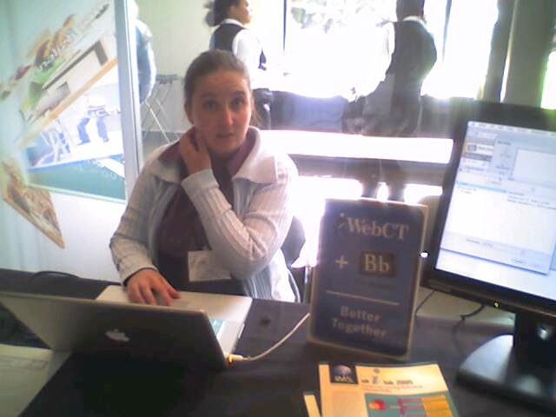
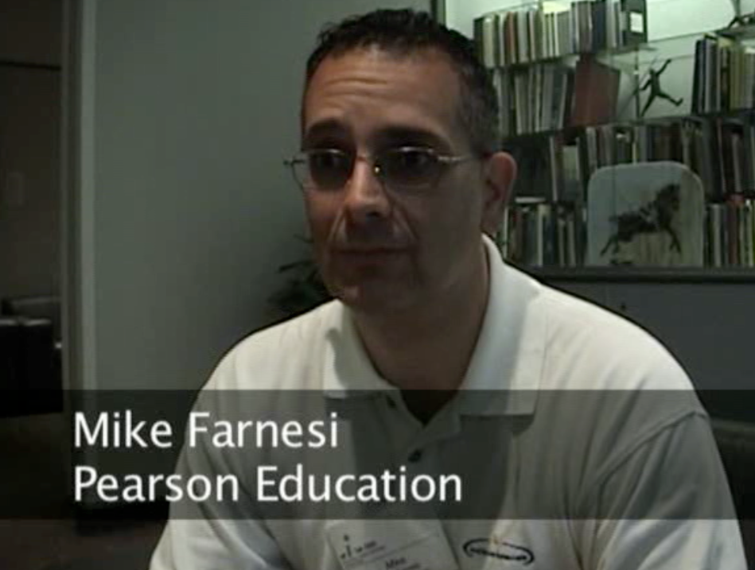
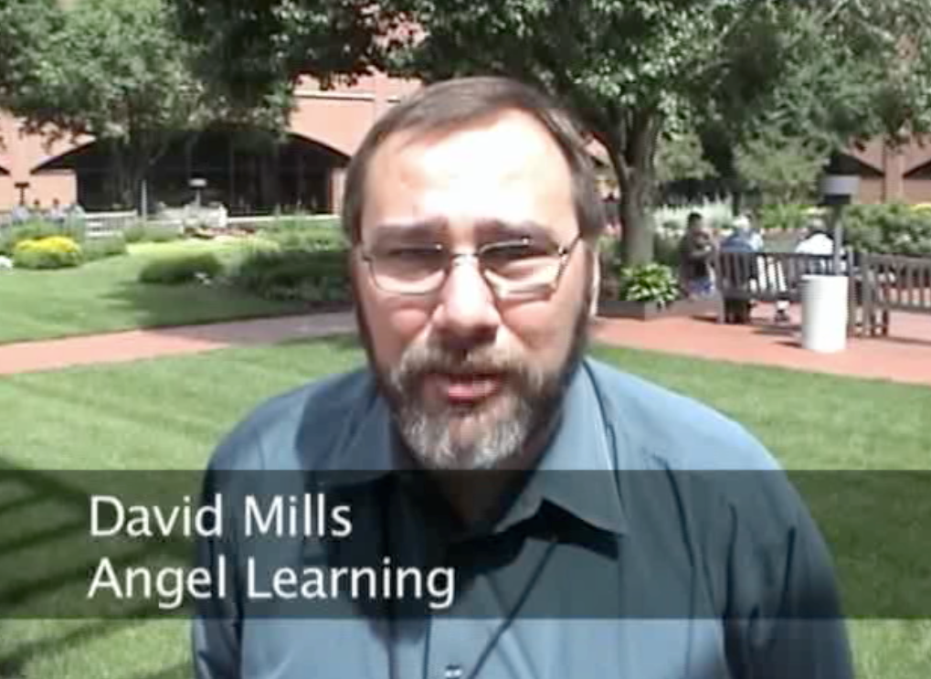
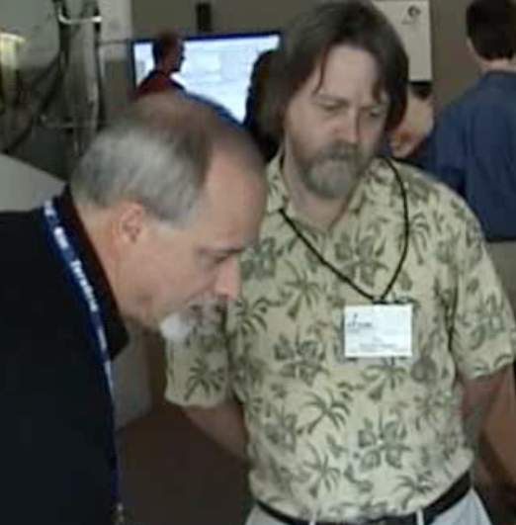
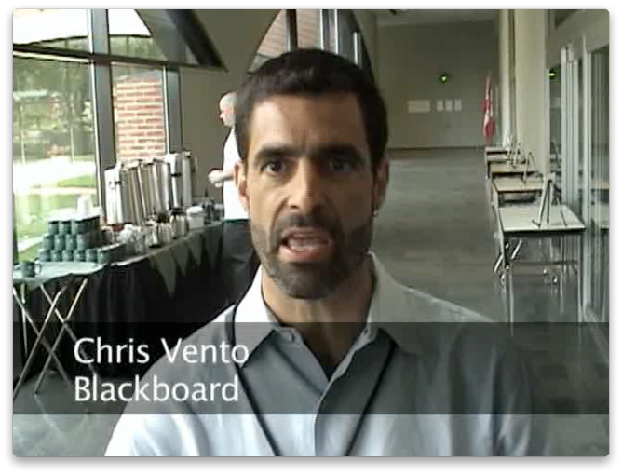
June 21, 2006
IMS Alt-I-Lab
Indianapolis, IN

Slide 19
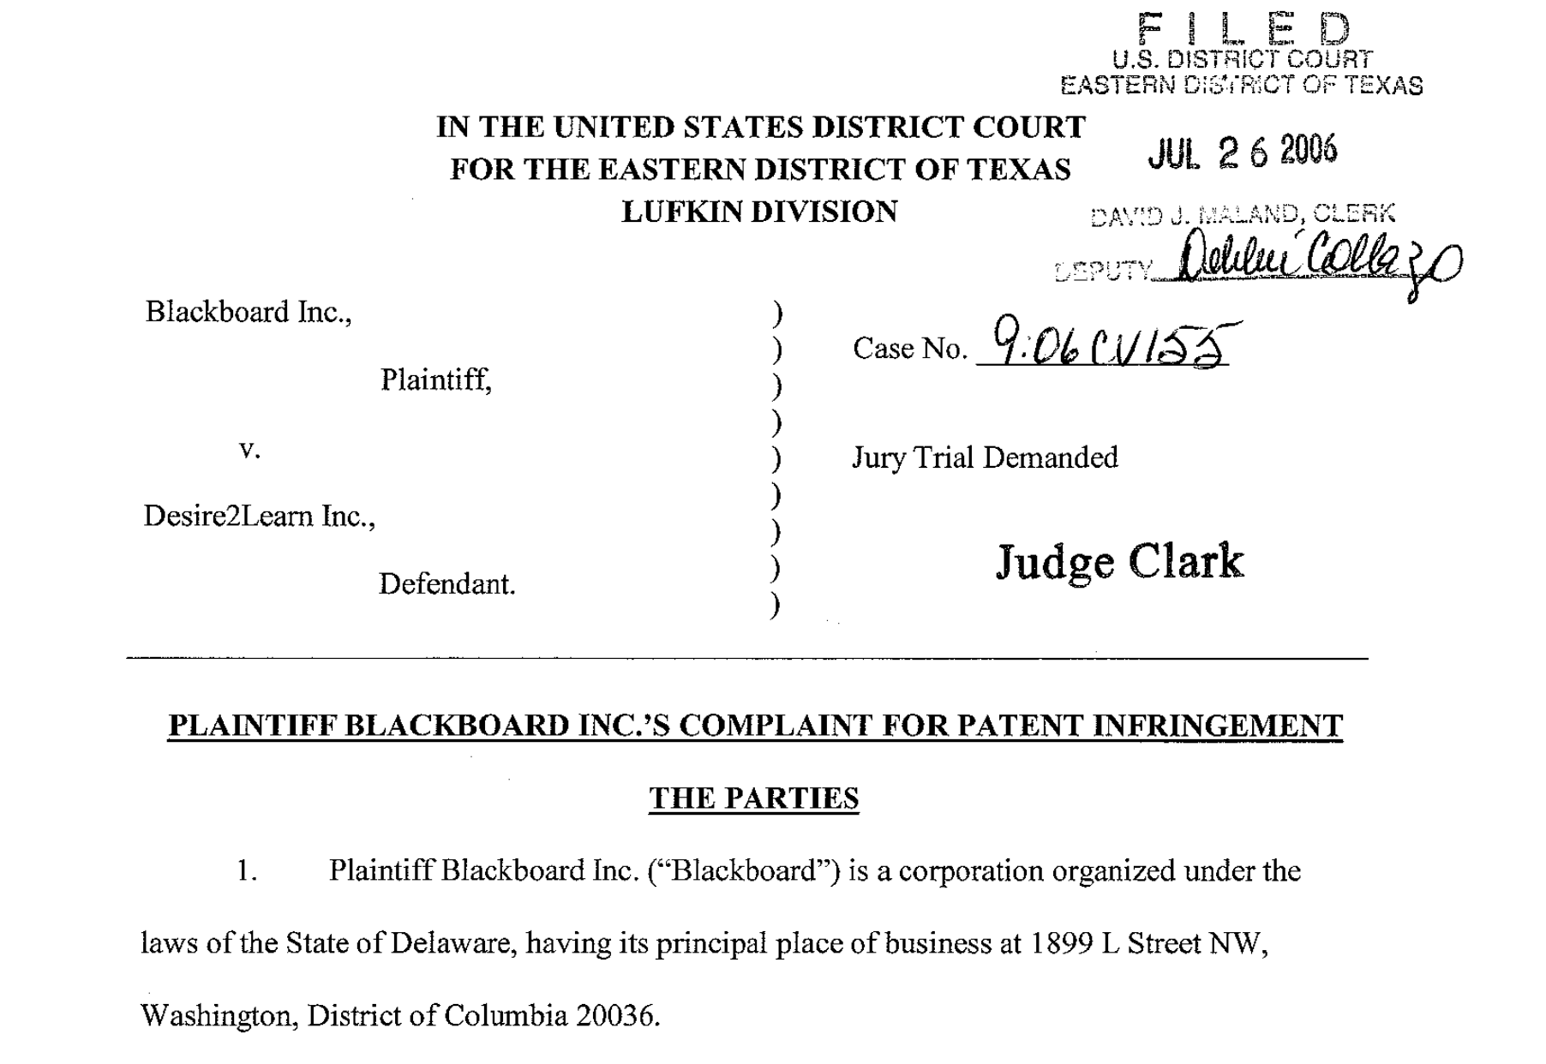

Slide 20
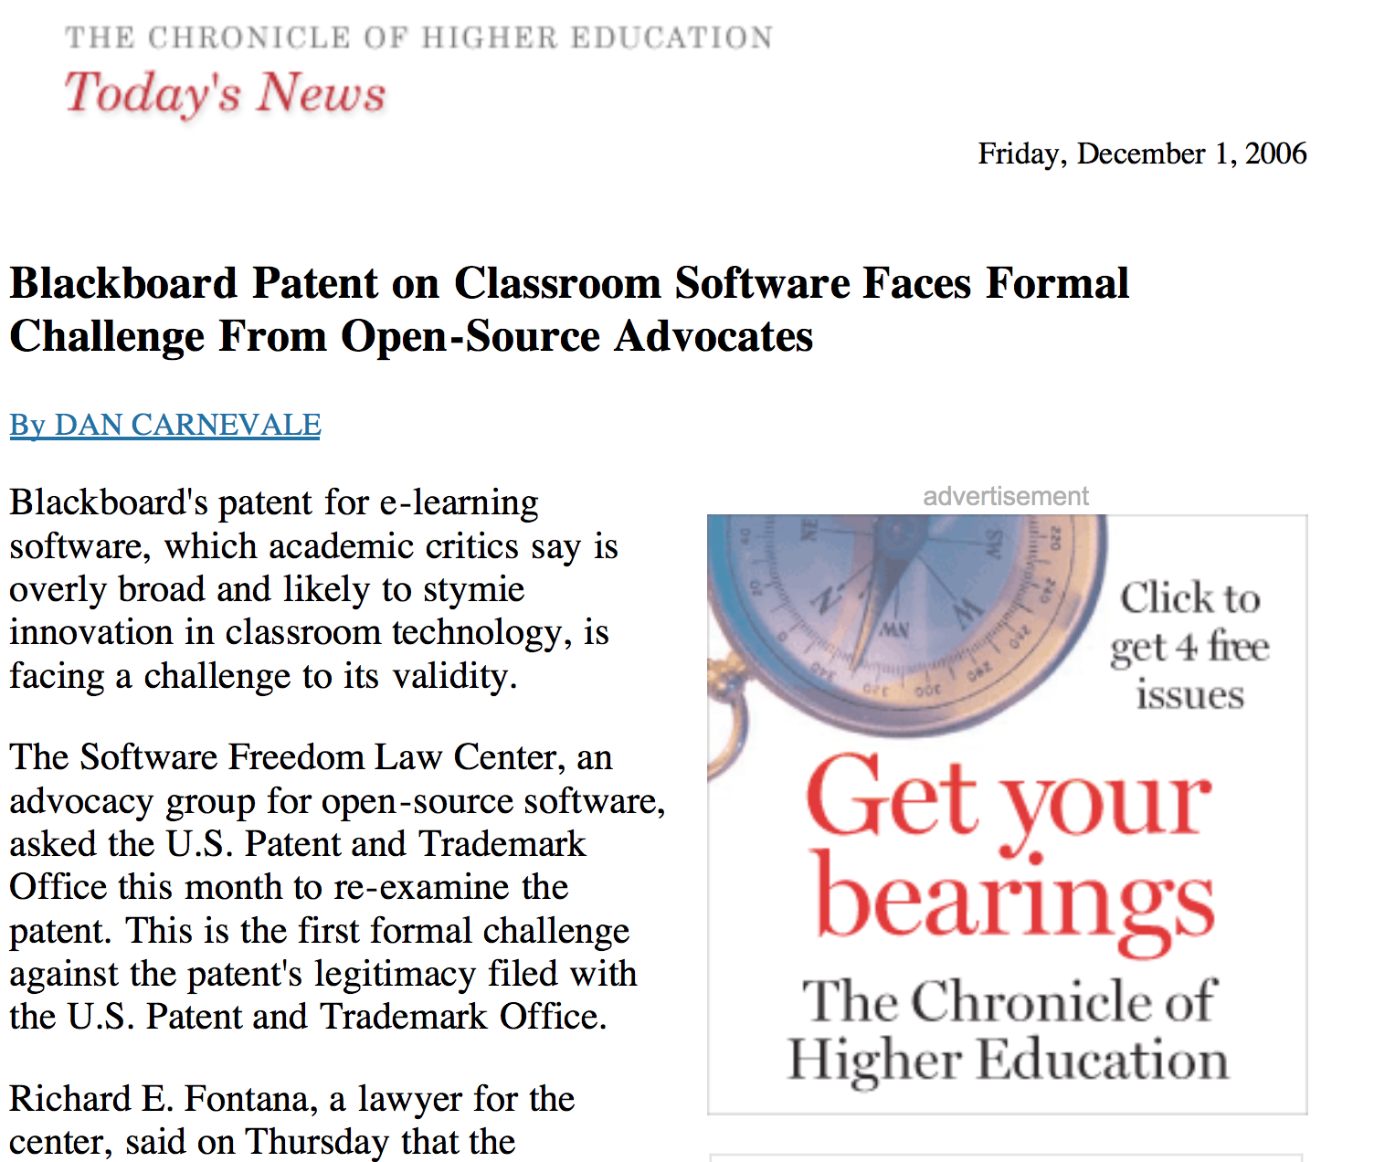
Patent Wars

Slide 21
Patent Resolved
Open Source – February 2007
Desire2Learn – December 2009

Slide 22
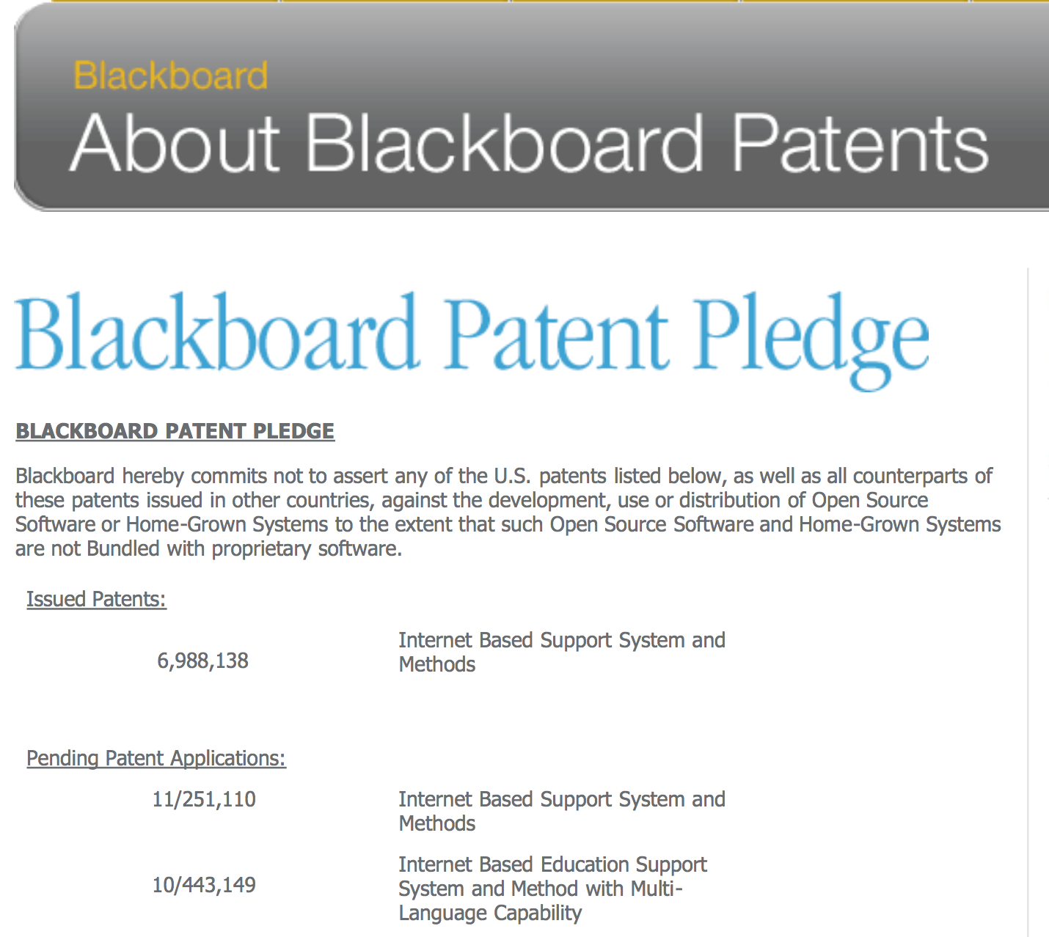

Slide 23
Standards Completed
IMS Tools Interoperability – Feb 28, 2006
IMS Common Cartridge 1.0 – October 2008
IMS LTI 1.0 – June 15, 2010
IMS Common Cartridge 1.1 – May 2011
IMS LTI 1.1 – August 2012

Slide 24
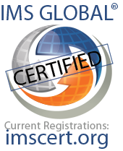

2015 to date only

Slide 25
A Three-Act LMS Play
https://en.wikipedia.org/wiki/Three-act_structure

Slide 26
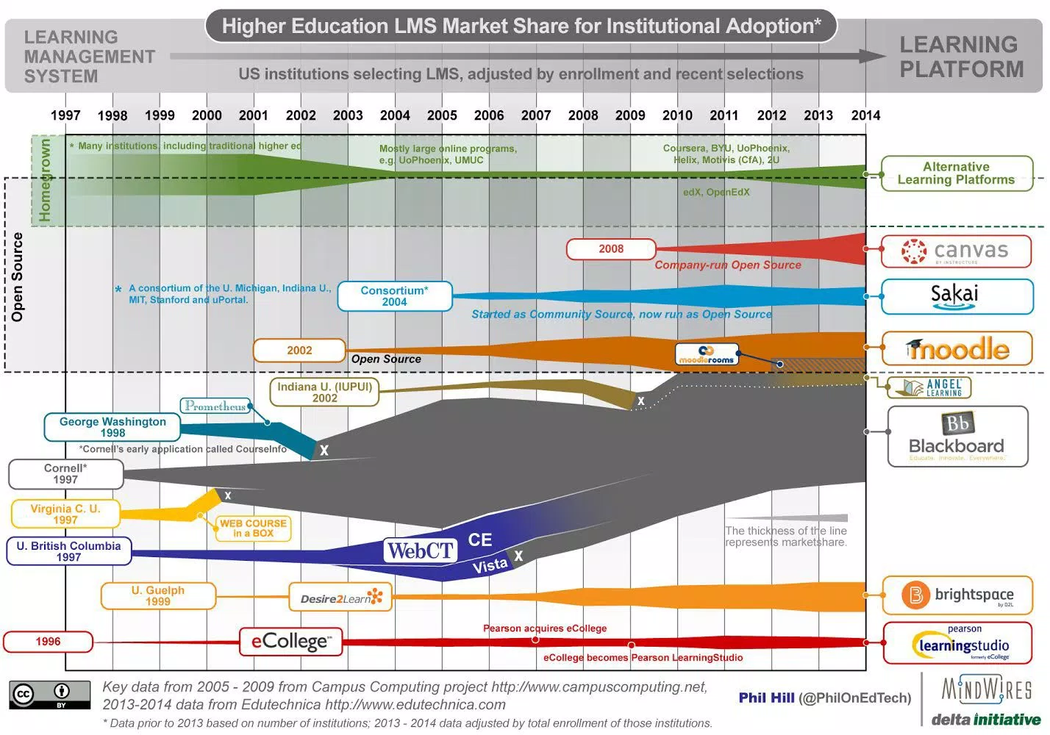

http://mfeldstein.com/back-to-the-future-looking-at-lms-forecasts-from-2011-2014/

Slide 27
If you were starting to write an LMS in 2008....
You would build it based on IMS LTI as *the* integration strategy
You would use IMS Common Cartridge as the import and export format
You would slickly extend both specs to make next-generation integrations

Slide 28

If you were starting to write an LMS in 2008....
You would release *part* of your LMS as open source so Blackboard could not sue you under its patents....
You would make nice REST/JSON APIs for everything
You would not use iframes or framesets
You would use JQuery
You would not support IE 6

Slide 29
http://mfeldstein.com/back-to-the-future-looking-at-lms-forecasts-from-2011-2014/

Slide 30
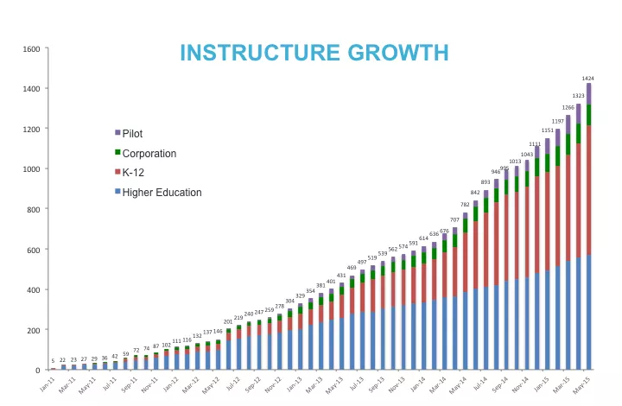

Slide 31
Act 1 - Summary

Slide 32
Act 2 - Summary

Slide 33
But there is more...

Slide 34
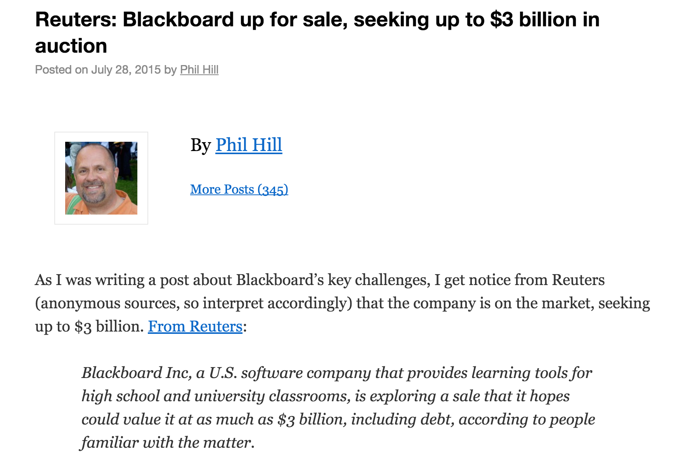
http://mfeldstein.com/reuters-blackboard-up-for-sale-seeking-up-to-3-billion-in-auction/

Slide 35
A Three-Act LMS Play
https://en.wikipedia.org/wiki/Three-act_structure

Slide 36
D'Arcy Norman's Law of eLearning Tool Convergence
Any eLearning tool, no matter how openly designed, will eventually become indistinguishable from a Learning Management System once a threshold of supported use-cases has been reached.
http://darcynorman.net/2013/02/15/normans-law-of-elearning-tool-convergence/
Notes:
Protagonist has changed – Michael Chasen is gone, Josh Coates is in.

Slide 37
Canvas Advantages
Most recent code base
Standards-first approach
Embrace-Extend-Enhance
Dis-intermediate local LMS admin – empower the teacher

Slide 38
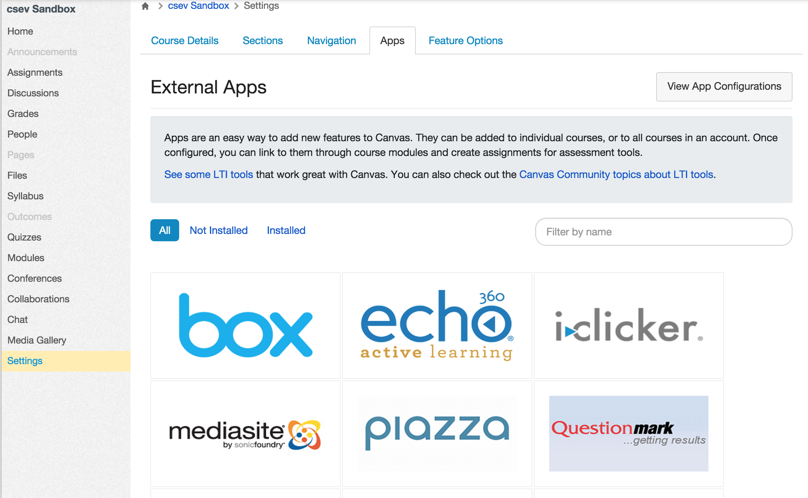

Slide 39
Future Structure
The power structure in the market place is shifting
It is no longer about one more feature in the LMS
It is about the number and quality of external tool integrations
It is about empowering teachers

Slide 40
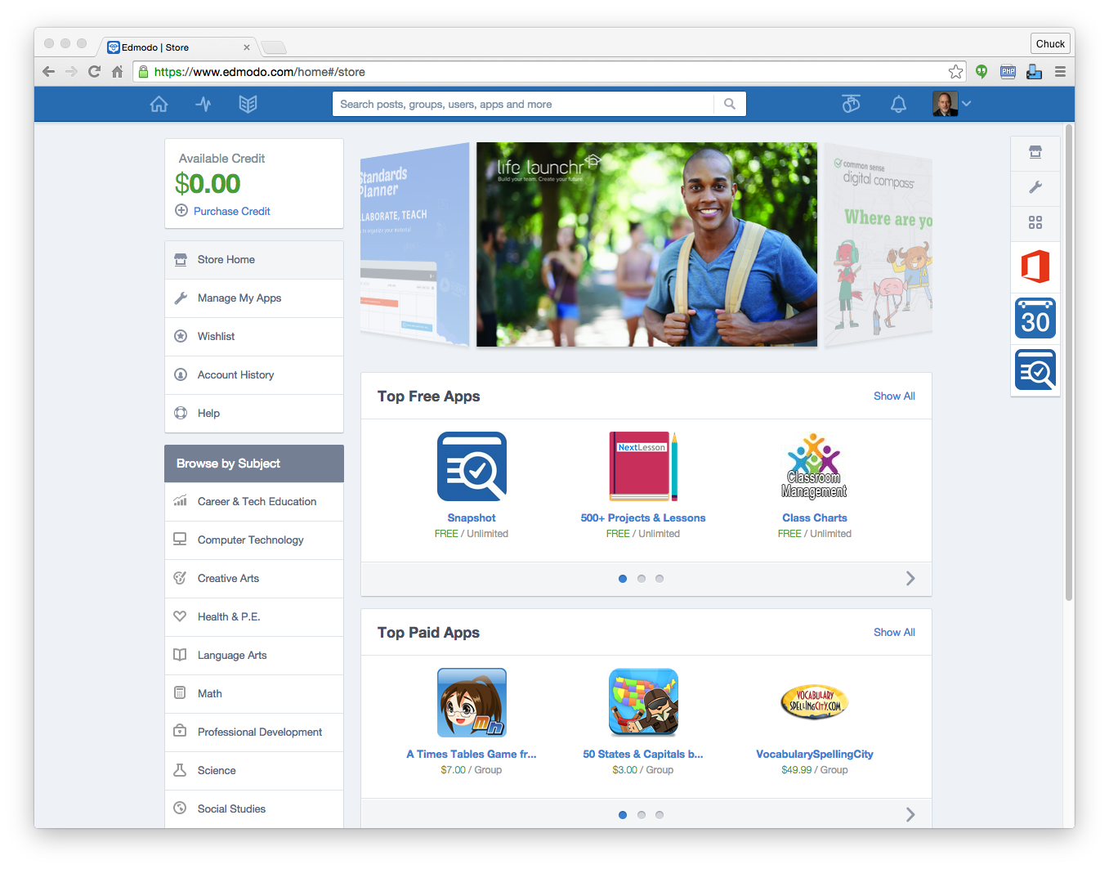

Slide 41
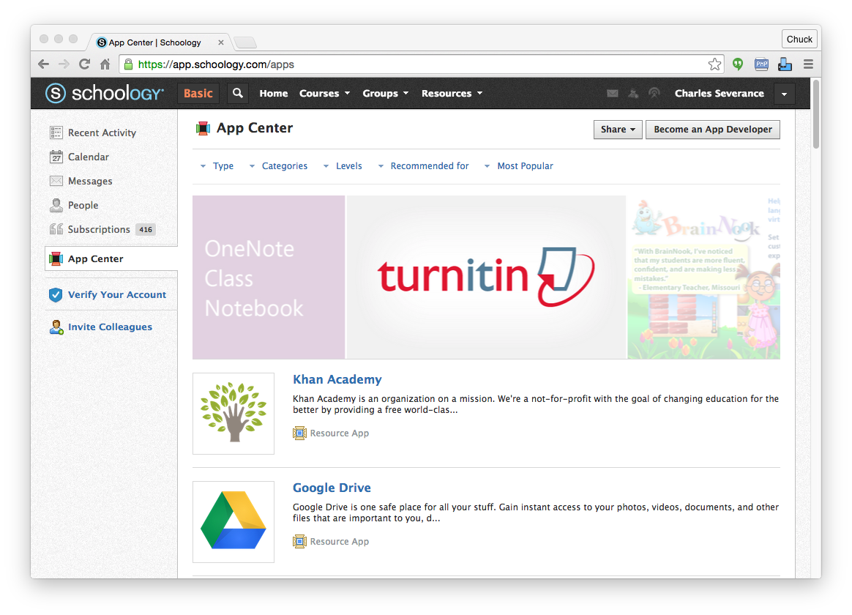

Slide 42
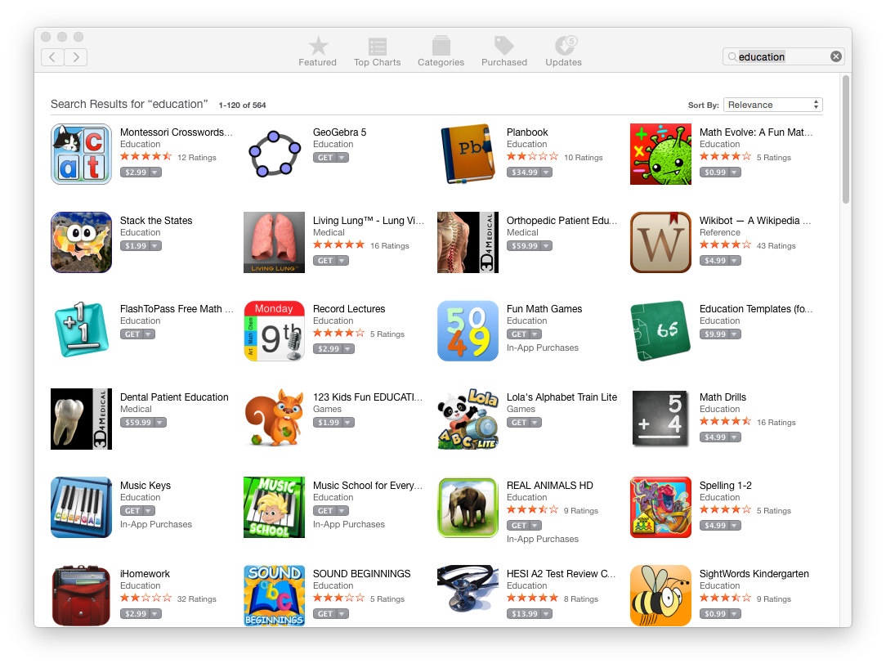


Slide 43
A "post-LMS" Ecosystem
Interoperable application stores
Un-bundling
Better Standards
Beautiful and rich integrations
Teacher-centered ecosystem of tools and content

Slide 44



APPS &
TOOLS
PARTNER
APP
CATALOG
SUPPLIER/
DEVELOPER
ANALYTICS
Seamless Enterprise Integration via IMS Standards
Peer-to-peer network
Click
Stream
LEARNING
PLATFORM/
PORTAL/LOR
Apps
INSTITUTION
ANALYTICS
Data
INSTITUTION
APP
CATALOG
Metadata
Interventions
IMS Community
App Sharing
Architecture (CASA)
STUDENT
INFO/ERP
SYSTEM
IMS Caliper
Analytics
Framework
Pathways
Achievements
IMS ARCHITECTURE
FOR EDUCATIONAL
INNOVATION
Competency Requirements Record
Electronic Transcript Supplement

Slide 47
IMS Standards Pipeline
Learning Tools Interoperability 2.1
LTI Content Item 1.0
LTI Membership Services Version 1.0
LTI Outcomes Management Version 2.0
IMS Caliper 1.1
IMS OneRoster

Slide 48
A Three-Act LMS Play
https://en.wikipedia.org/wiki/Three-act_structure

Slide 49
My Research..
How do we we move the market to the next generation teaching and learning systems?
My focus is moving from protocols to APIs
www.tsugi.org

Slide 50
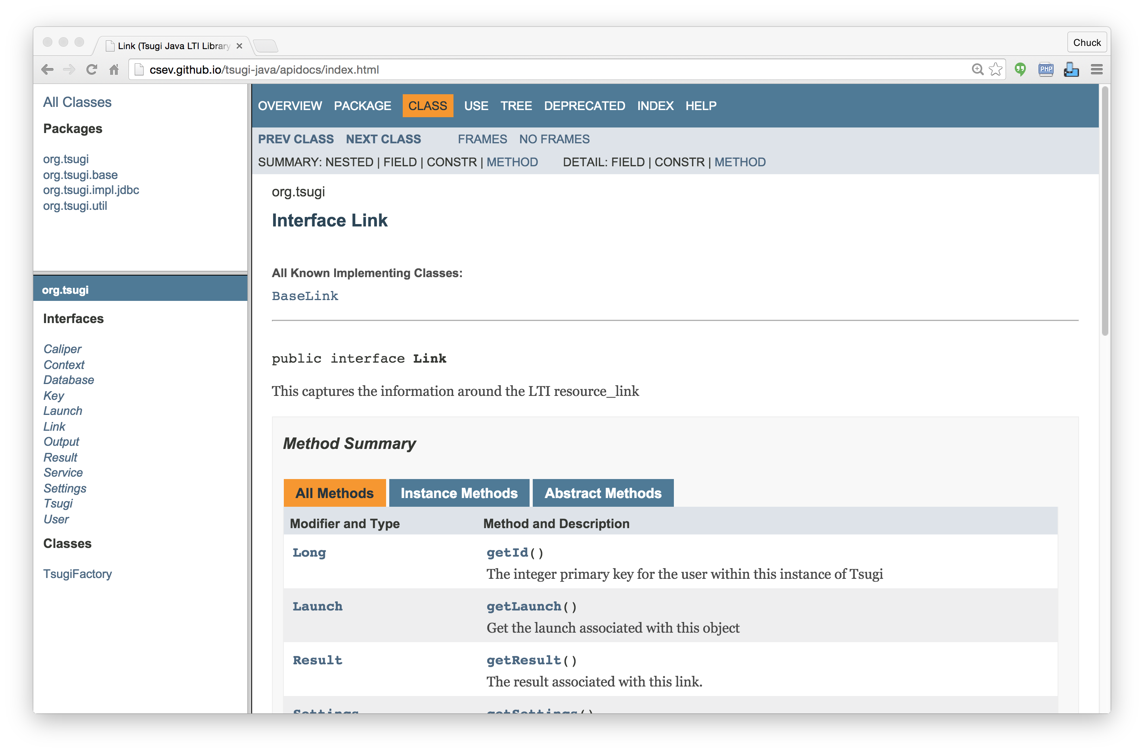

Slide 51
TL;DR
LTI is the answer in the short term
The "post-LMS" era is coming – interoperable standards will be at its core
LTI is the answer in the medium term too...

